Slide 1


National Conference on Recent Advancements In Engineering and Technology: RAET'25
STUDENT ENGAGEMENT DETECTION IN E-LEARNING
VIVEK RAJEEV V
ABHINAV K
SWATHI KRISHNA
ANUSREE K
CLARA JOSEPH

Slide 2
OUTLINE
Introduction
Objective
Problem definition
Proposed System
Architecture Diagram
Implementation Details
Project Outcome
Conclusion

Slide 3
Introduction
In this era of online learning, monitoring student engagement has become a major challenge for educators. In traditional classrooms, teachers can gauge attention through body language and facial expressions, but these signals are harder to capture in virtual settings.
Student engagement is crucial for effective learning, so finding ways to track it accurately in online platforms is important.
Our project introduces a system that uses computer vision and deep learning to automatically detect student engagement

Slide 4
Objective
Student Engagement detection aims to encourage the students to stay in-front of the screen in time of online classes
Enables the teacher to monitor the student’s focus on learning as done in real class.
It helps to teacher to give reward to the students in the form of attendance.
It also provides a place for teachers to provide online class link to students Also enables the teachers to evaluate their class based on the engagement level of the students

Slide 5
Problem definition
In online learning, it is difficult for educators to evaluate student engagement, as signs like facial expression and eye movements are harder to observe.
This can lead to reduced participation and lower learning outcomes. Current methods of tracking engagement, such as self-reports or quizzes, are often slow and unreliable.

Slide 6
Proposed System
The proposed system consist of two application one for the student and other for the teacher
Faculty Application: Link to the online class and details of the class can be updated by the teacher in the application. The faculty can view the report after when the online class is over. Live report of the students,presence in front of the camera will be reported to the faculty
Student App: Students can login using their user-id and password in the student app and view the links to the online classes upload by the teacher The app will start monitoring the student from the beginning of the online class. The AI models will make prediction every one second inturn generating the EI score and average of this prediction is taken in 60 seconds and the engagement state for that time will be recorded

Slide 7
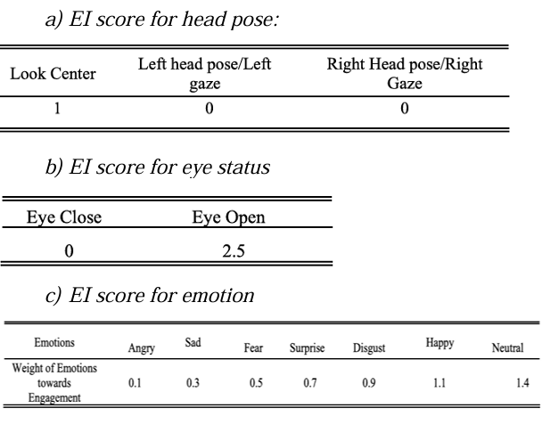
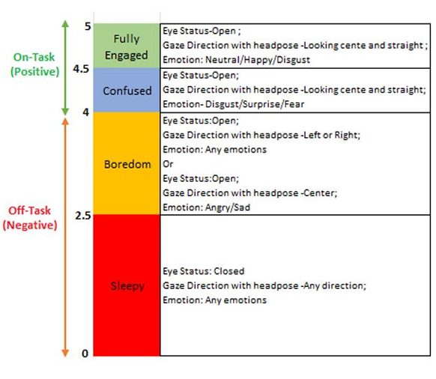
Contd.
EI score calculation

Slide 8
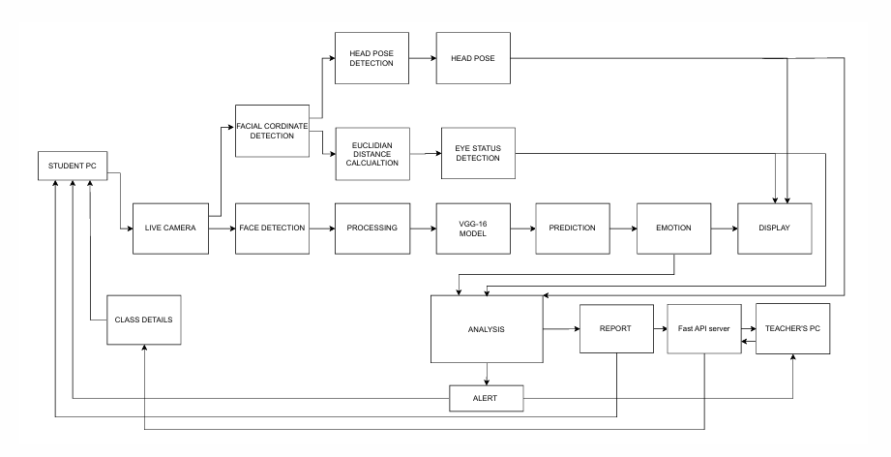
Architecture Diagram

Slide 9
Implementation Details
Python programming language is used in the development of the project
Pyqt module is used to develop the gui for the project
The backend server is built using FastAPI

Slide 10
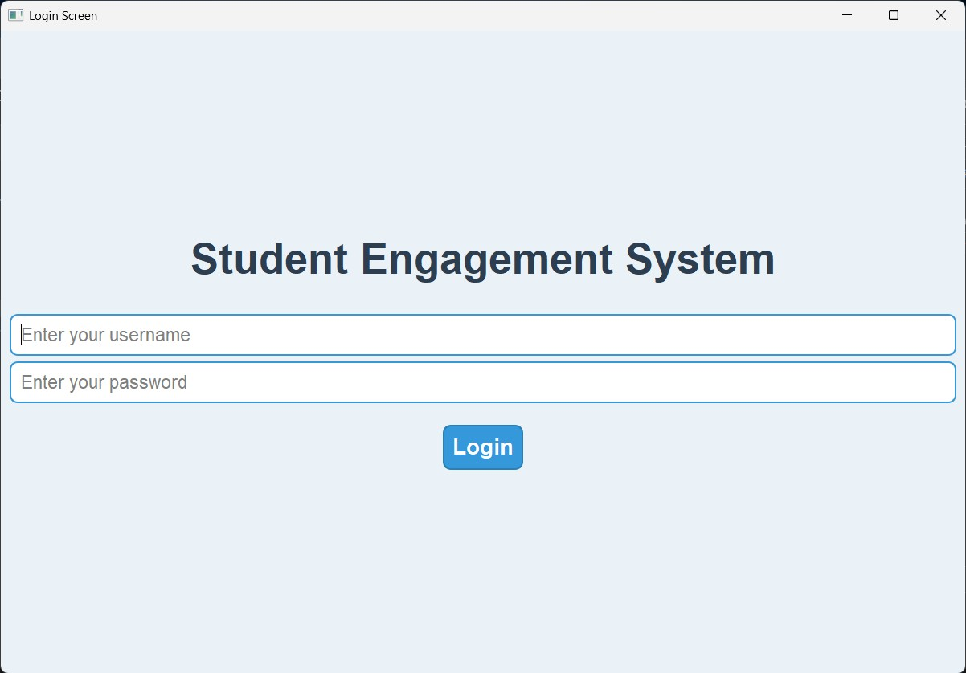
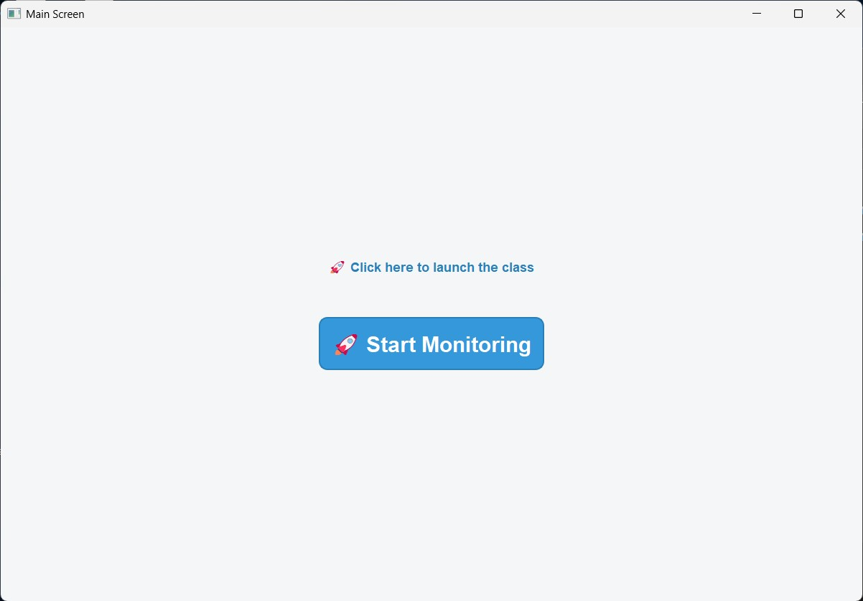
Project Output
Student application

Slide 11
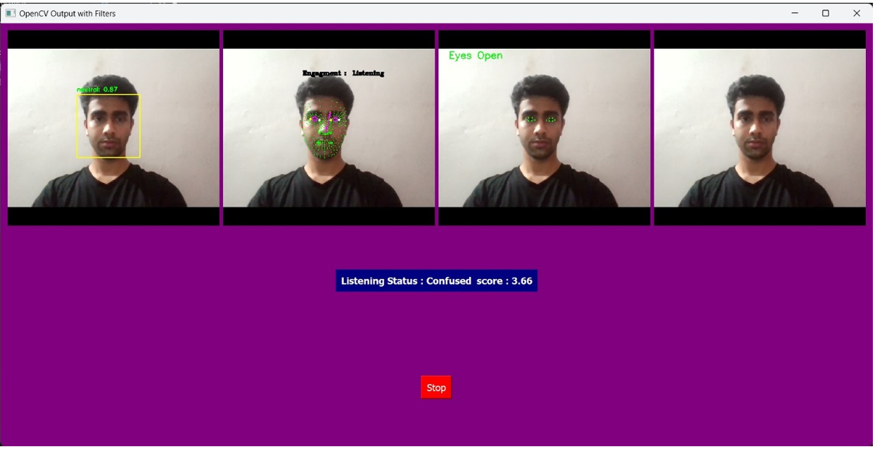

Slide 12
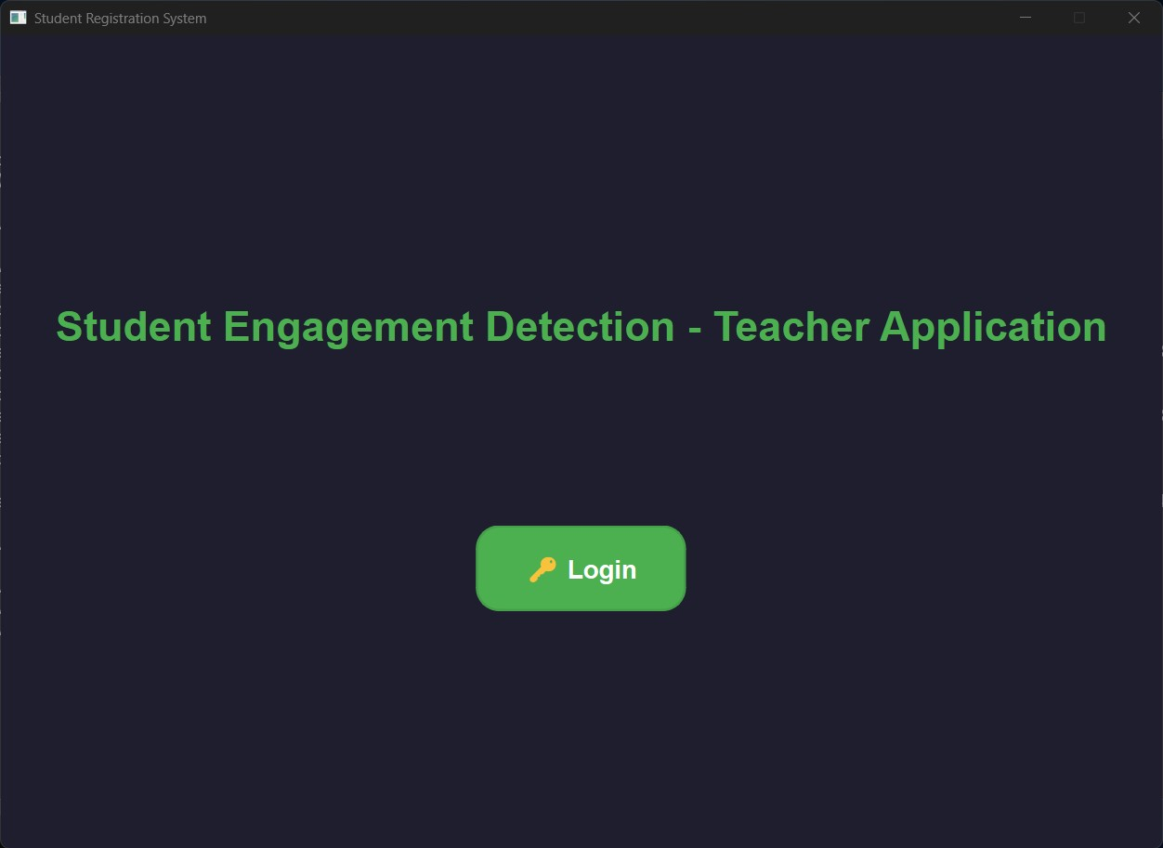
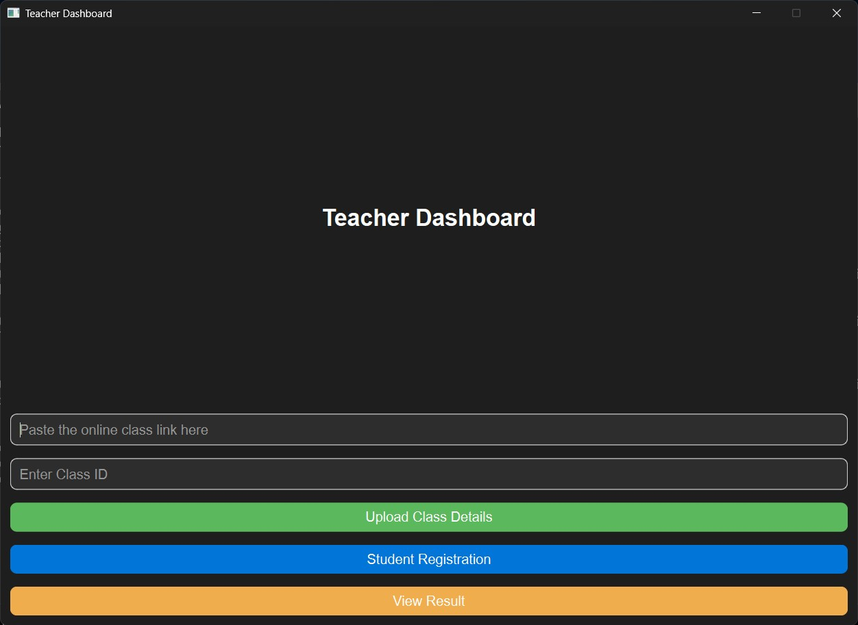
Teacher application

Slide 13
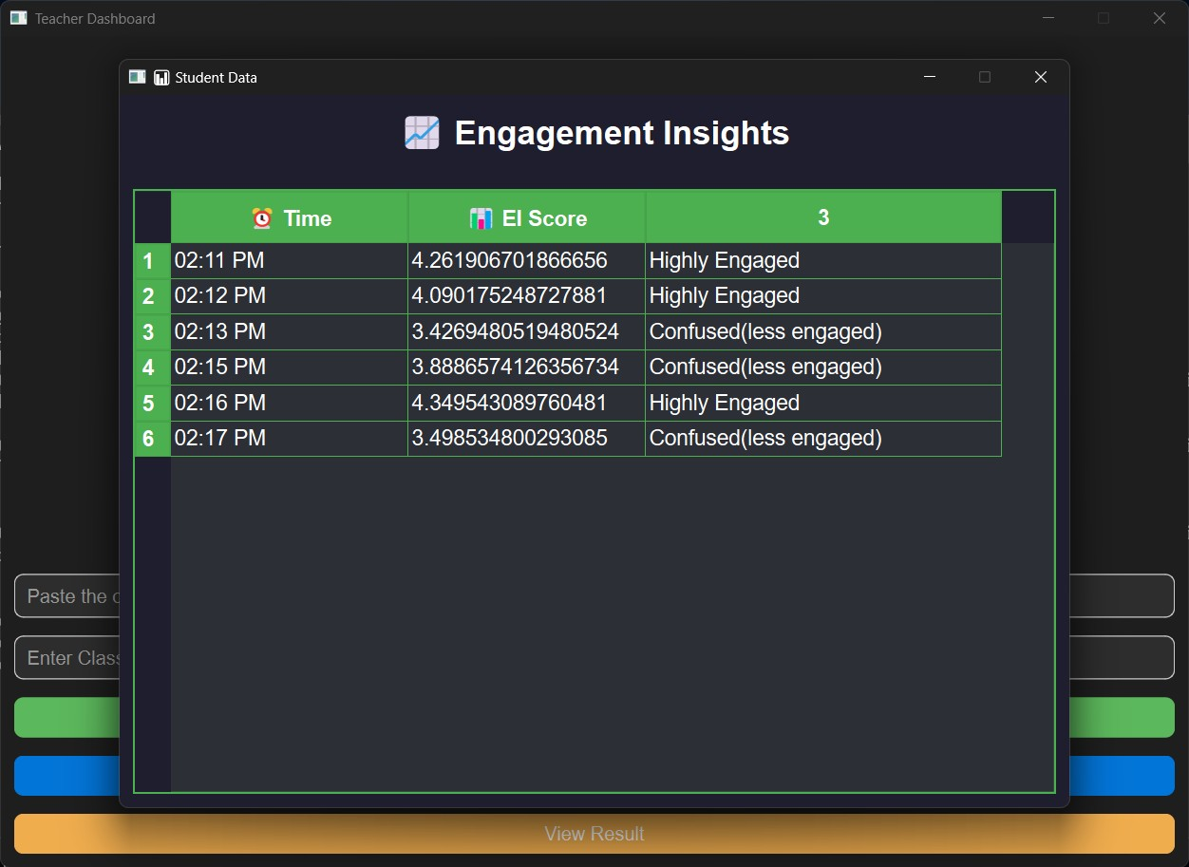

Slide 14
Conclusion
This project successfully implements a Student Engagement Detection System using FastAPI and PyQt6.
It enables real-time collection and monitoring of Engagement Index (EI) scores, storing minute-wise averages in a MySQL database.
The modern PyQt6 GUI provides an intuitive interface for teachers to manage student data and engagement tracking. With real-time updates and seamless performance, this system enhances classroom monitoring and can be expanded with AI analytics and mobile integration in the future.

Slide 15
THANK YOU..

Slide 16
ANY QUERIES????

